Slide 1

MINI WIND TURBINE FOR URBAN ENERGY GENERATION
KNOWLEDGE INSTITUTE OF TECHNOLOGY

Slide 2
MINI WIND TURBINE FOR URBAN ENERGY GENERATION
KNOWLEDGE INSTITUTE OF TECHNOLOGY
Smart IoT-Based Renewable Energy Generation & Monitoring System
Main Technologies:
ESP32
Blynk IoT
Voltage & Current Monitoring
Battery Energy Storage

Slide 3
Double Content Slide
KNOWLEDGE INSTITUTE OF TECHNOLOGY
Smart Urban Wind Energy System
An IoT-based system that converts wind energy into electrical energy using a mini wind turbine.
The generated energy is stored in a rechargeable battery, while ESP32 monitors voltage, current, power, and battery status.
The data is displayed locally on an OLED display and remotely through the Blynk IoT platform.
Objective
To develop a compact and low-cost renewable-energy system suitable for urban and small-scale applications.

Slide 4
Bulleted List Slide
KNOWLEDGE INSTITUTE OF TECHNOLOGY
Mini Wind Turbine – Captures wind energy
Generator – Produces electrical energy
Bridge Rectifier – Converts AC to DC
Charging Module – Controls battery charging
Battery – Stores generated energy
ESP32 – Main controller
Voltage Sensor – Measures voltage
ACS712 – Measures current
OLED – Local monitoring
Blynk IoT – Remote monitoring

Slide 5
Comparison Slide
KNOWLEDGE INSTITUTE OF TECHNOLOGY
Compare Section
Contrast Section
Similar to existing renewable-energy systems, the project uses a wind turbine to generate electricity and sensors to monitor the electrical output.
The system uses a microcontroller to process and display the measured parameters.
Unlike a conventional mini wind turbine with only local measurement, this system integrates ESP32 and Blynk IoT.
The user can monitor the turbine's electrical performance remotely through a Blynk dashboard.

Slide 6
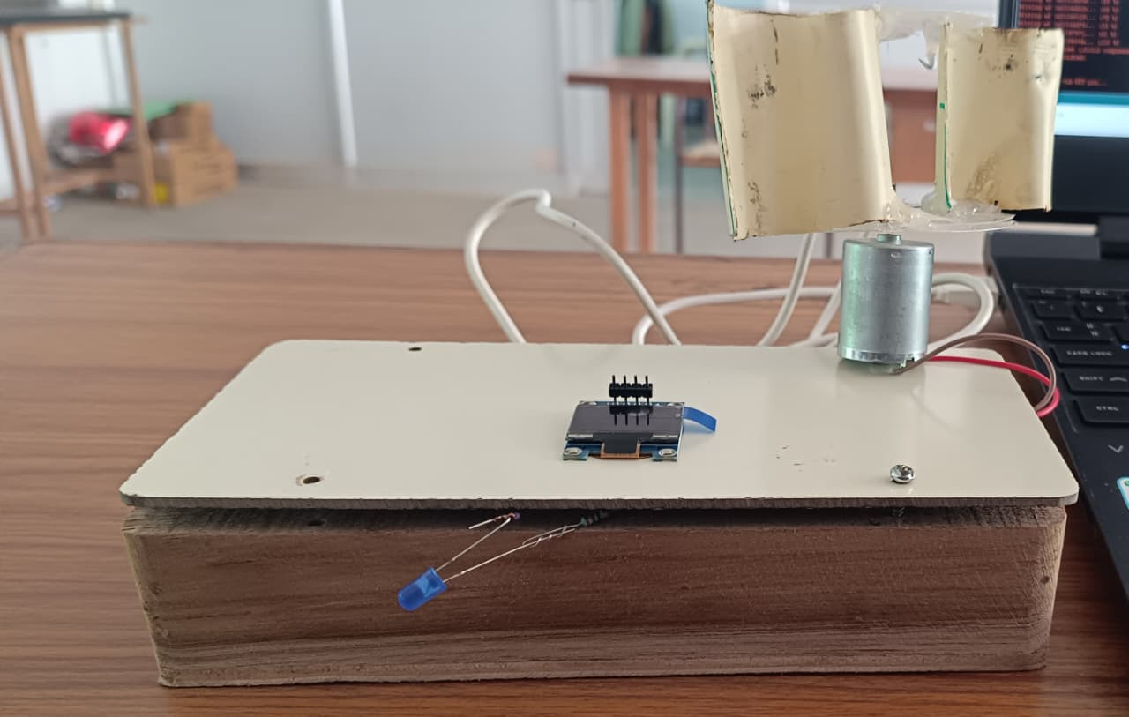
Prototype
KNOWLEDGE INSTITUTE OF TECHNOLOGY
The prototype consists of a compact mini wind turbine connected to a generator.
The generated electrical energy is processed through the rectifier and charging circuit before being stored in the battery.
The ESP32 monitors the electrical parameters using voltage and current sensors.
The system provides both local OLED monitoring and remote Blynk monitoring.

Slide 7
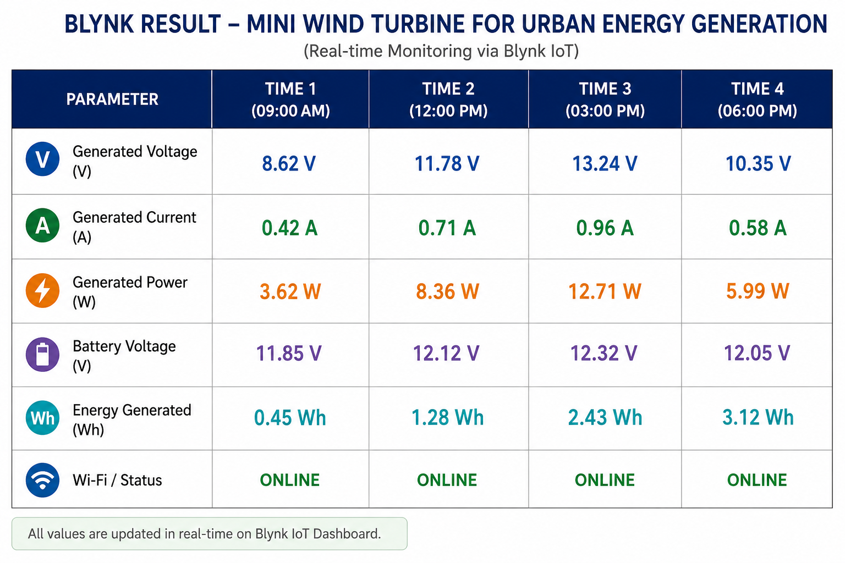
Detection Breakdown
KNOWLEDGE INSTITUTE OF TECHNOLOGY

Slide 8
CONCLUSION
KNOWLEDGE INSTITUTE OF TECHNOLOGY
Smart Renewable Energy for Urban Applications
The Mini Wind Turbine for Urban Energy Generation combines renewable energy generation with modern IoT technology.
The integration of ESP32, voltage sensor, ACS712 current sensor, OLED display, battery storage, Wi-Fi, and Blynk IoT provides both local and remote monitoring.
The project demonstrates a practical approach to small-scale urban renewable-energy generation and provides a strong foundation for future smart-energy applications.

